Slide 1


Airport Luggage Simulation

Slide 2
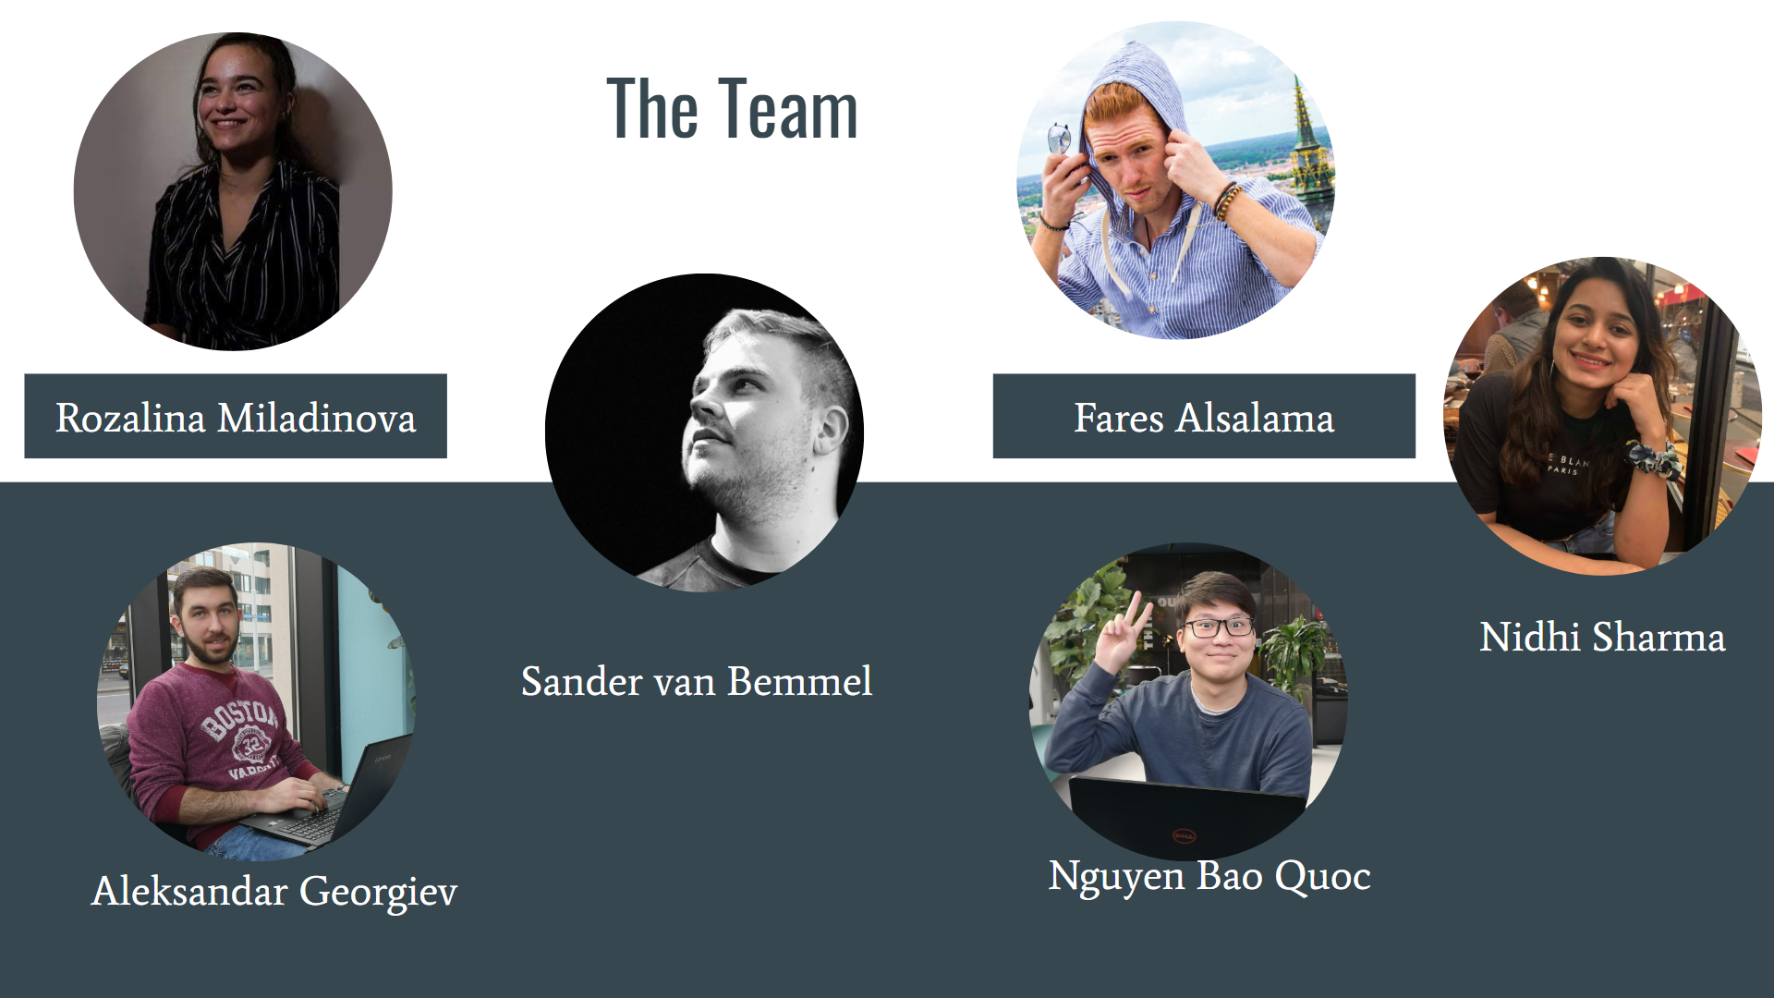

Slide 3
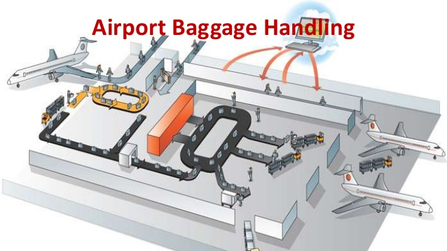
Our Client and Our Task

Slide 4

Initial Phase
Iteration 1
Iteration 2
Iteration 3
End Phase

Slide 5

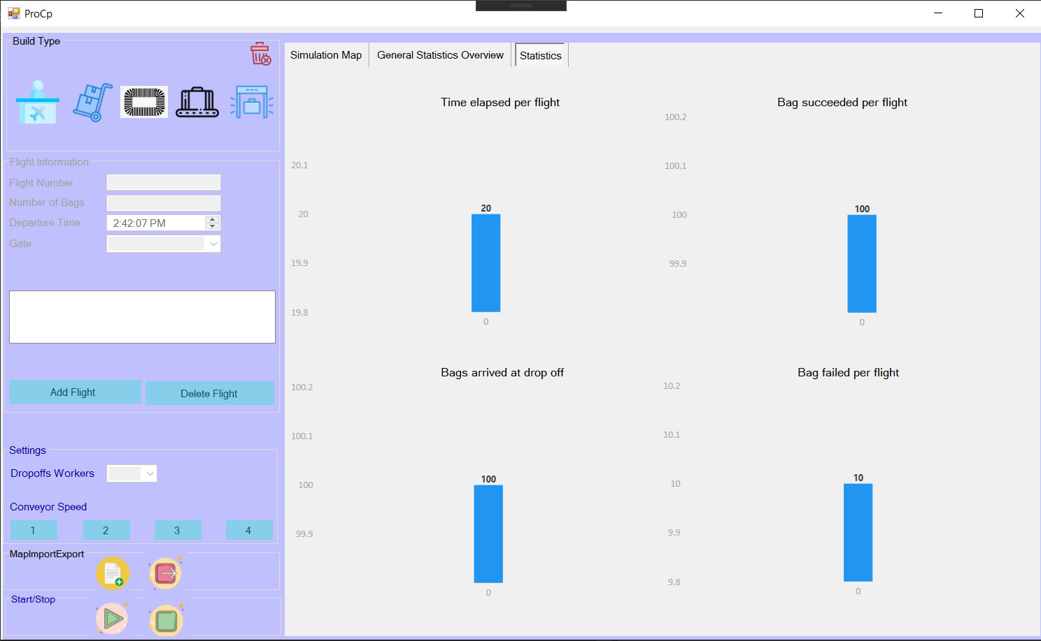
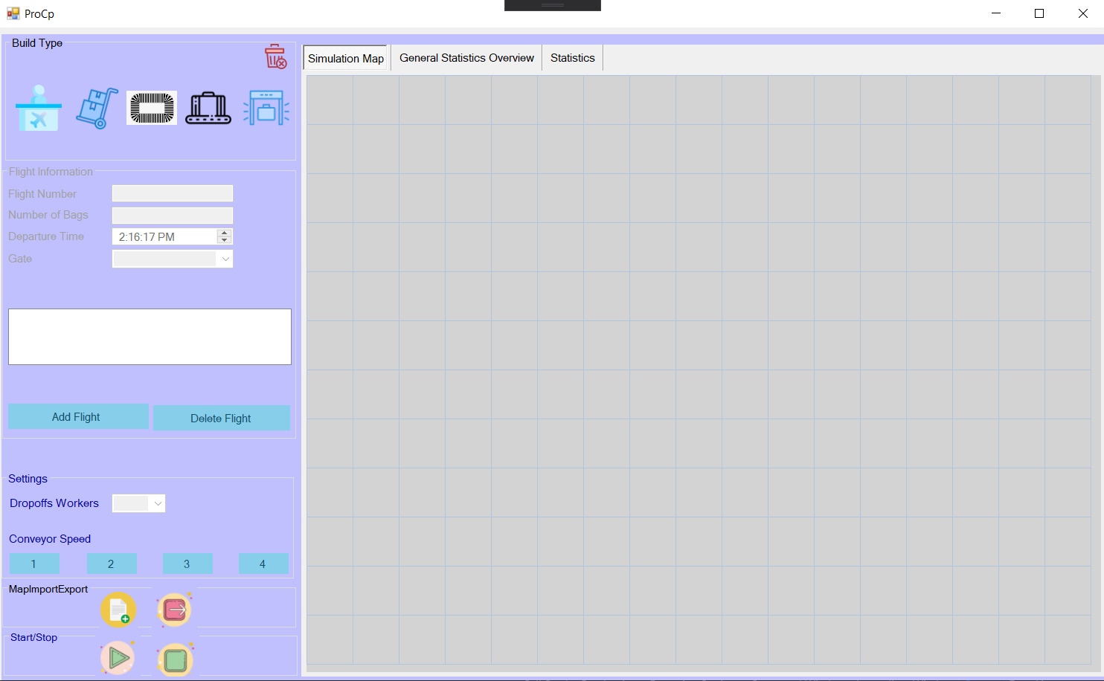
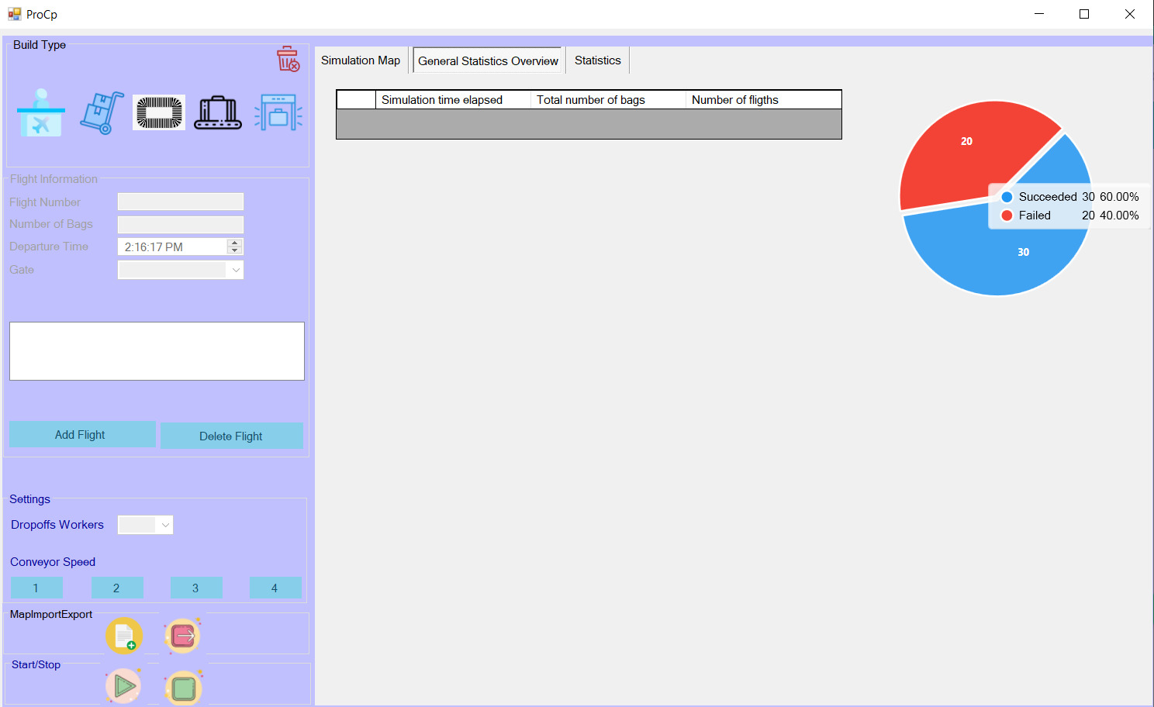
Our Application

Slide 6
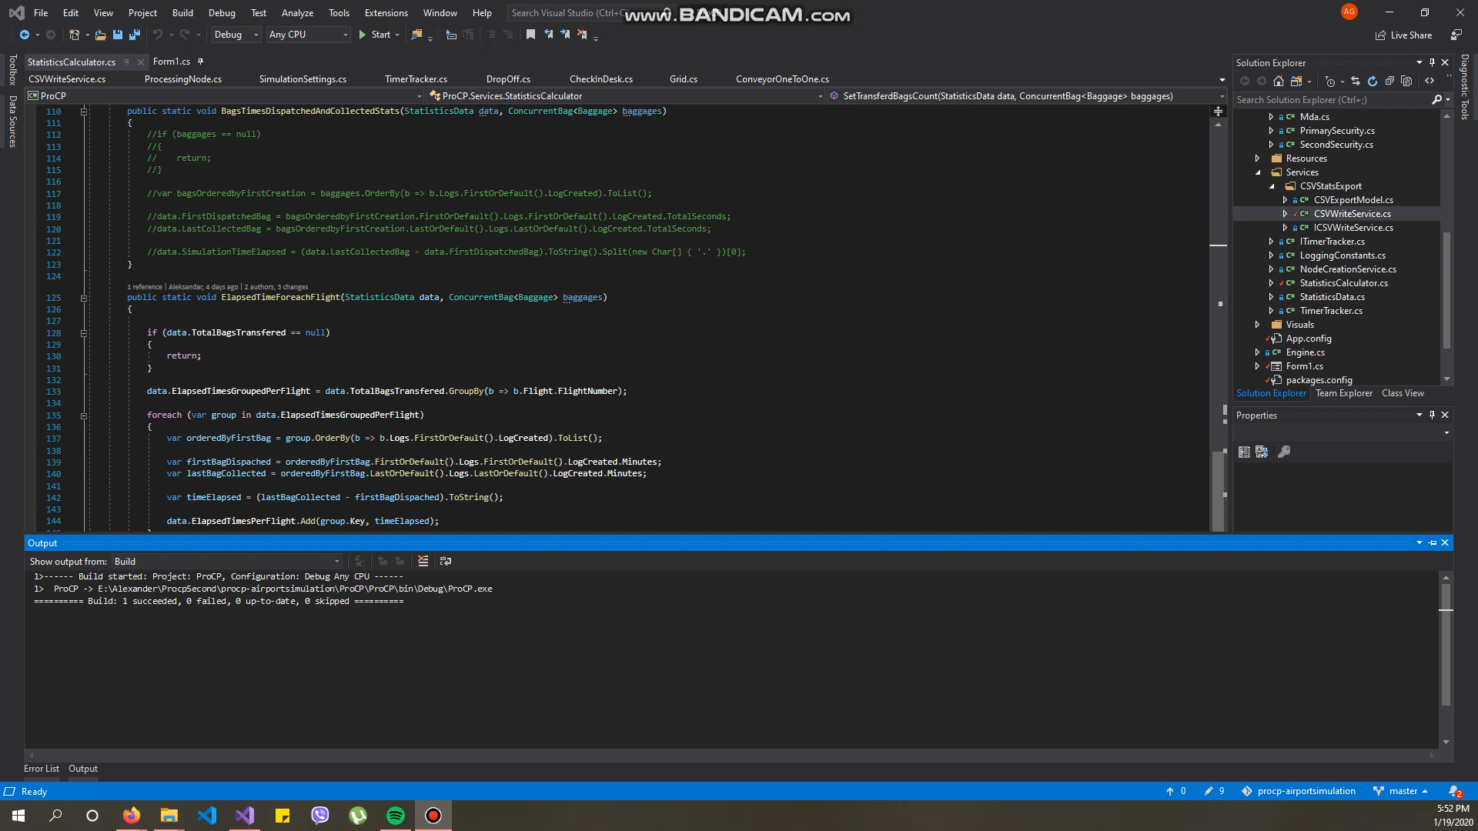
Short Demo

Slide 7


Slide 8

Questions

